Slide 1
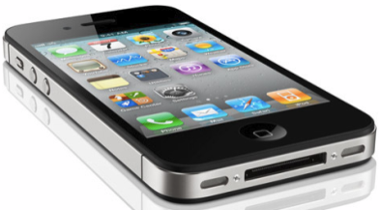


iOS Mobile Application Security (iMAS)
FY13 MITRE Research
August 2013
Research Team: Gregg Ganley(PI) and Gavin Black

Slide 2
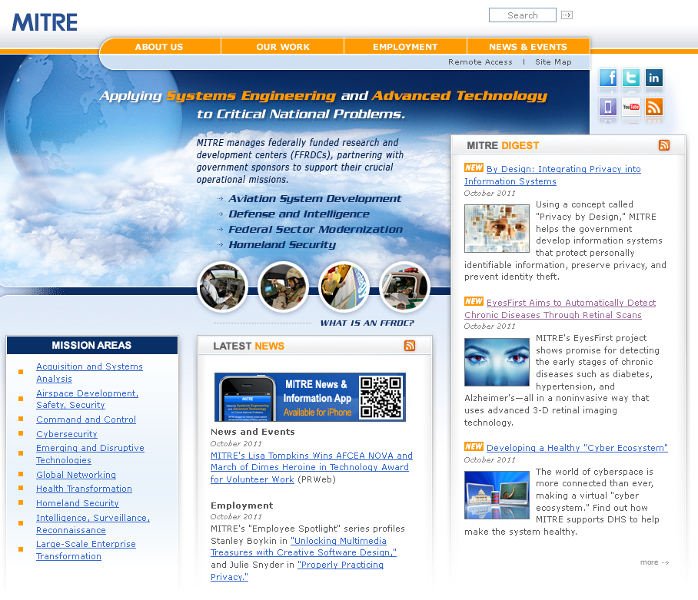
About MITRE
Not for profit, working in the public interest
MITRE does not manufacture products, enabling us to provide conflict-free guidance
MITRE operates several FFRDCs
DoD, FAA, IRS, VA, DHS, U.S. Courts
MITRE invests in an independent R&D (IR&D) program to ‘look ahead’ for our sponsors
© 2013 The MITRE Corporation. All rights reserved. Approved for Public Release: Case #13-2148

Slide 3

iOS Mobile App Security (iMAS) Elevator Pitch
iMAS – iOS application defense
iMAS – iOS secure, open source application framework to reduce iOS application vulnerabilities and information loss
© 2013 The MITRE Corporation. All rights reserved. Approved for Public Release: Case #13-2148

Slide 4
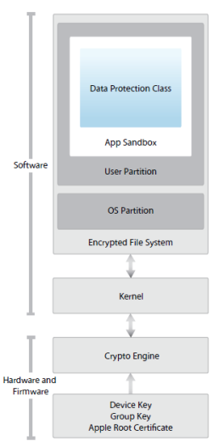
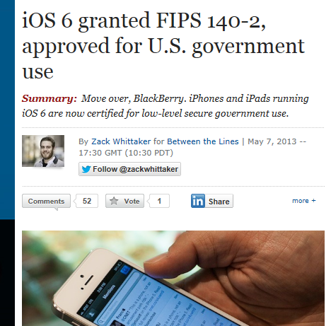
iOS Security Model
iOS four layers
Device - prevents unauthorized access to device
Data - protects data stored on the device
Network - protects data in transit
Application security – protects OS and isolates applications while they are running
iOS security
Reduced attack surface; no Java or Flash support, reduced PDF/.MOV features, stripped down system apps from full Mac OS X
iOS smaller footprint; no shell (/bin/sh), or rm, ls, ps, avail for exploit
Privilege separation; several iOS users (e.g., mobile, _wireless, root is limited)
Code Signing; binaries, libs, and pages in memory must be signed to exec
DEP / ASLR in place; limits exploits to ROP
Sandboxing; limits damage, makes exploitation harder
Security model is comprehensive; has evolved considerably since 2007; malware is difficult to craft and proliferate on iOS
FIPS compliance means custom enterprise apps, and the need for iMAS app security
© 2013 The MITRE Corporation. All rights reserved. Approved for Public Release: Case #13-2148
Notes:
http://en.wikipedia.org/wiki/Return-oriented_programming
http://en.wikipedia.org/wiki/Return-to-libc_attack
http://www.infosecwriters.com/text_resources/pdf/return-to-libc.pdf

Slide 5
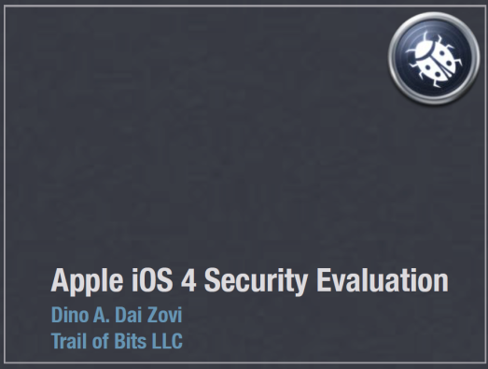
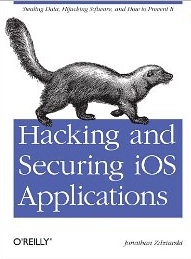
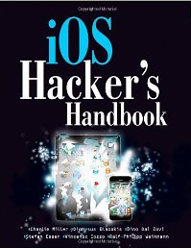
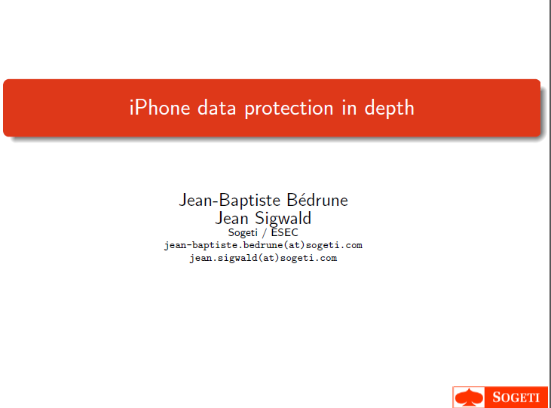
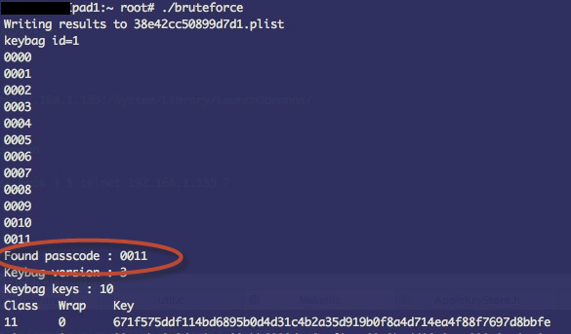
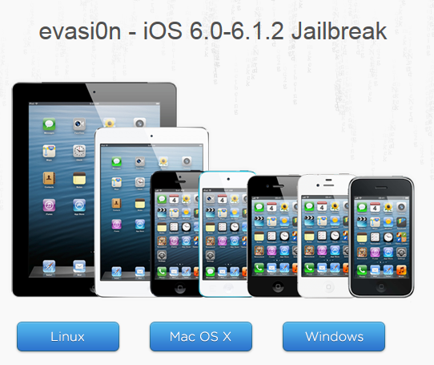
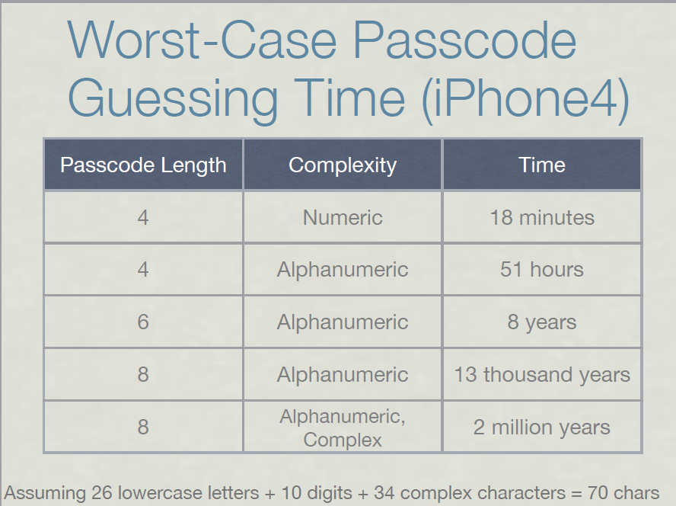
Hacking and Jailbreaking iOS
Attacks and weaknesses are well documented:
Recent Jailbreak: http://evasi0n.com/
Passcode
guessing:

Slide 6
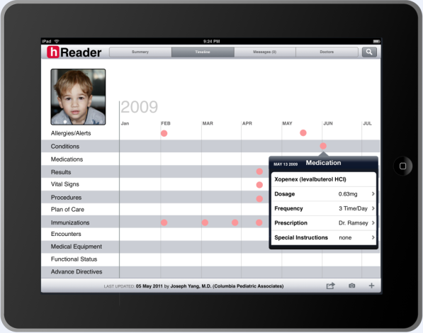
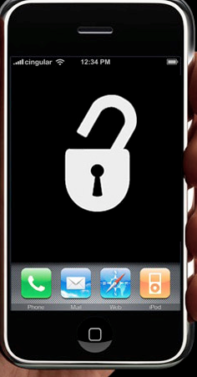
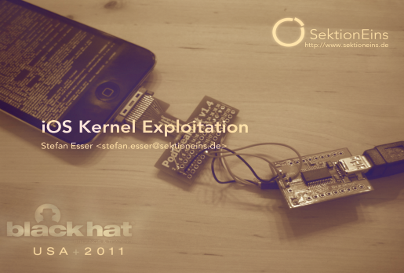
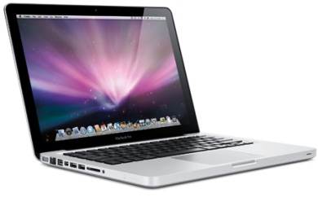
Problem: Standard iOS Application Today
4 Digit Passcode
Native iOS Application
App Store
App Signing
System components:
RAM and Debugger
Jailbreak / Root Access
User Auth
App Access
Keychain
Flash Data Storage
iOS Core Services
Internet
SSH / Debugger
iOS
iPhone / iPad Hardware
Vulnerable Areas

Slide 7


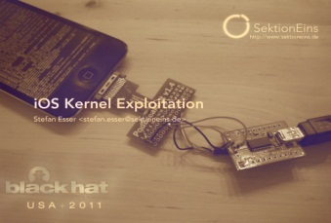


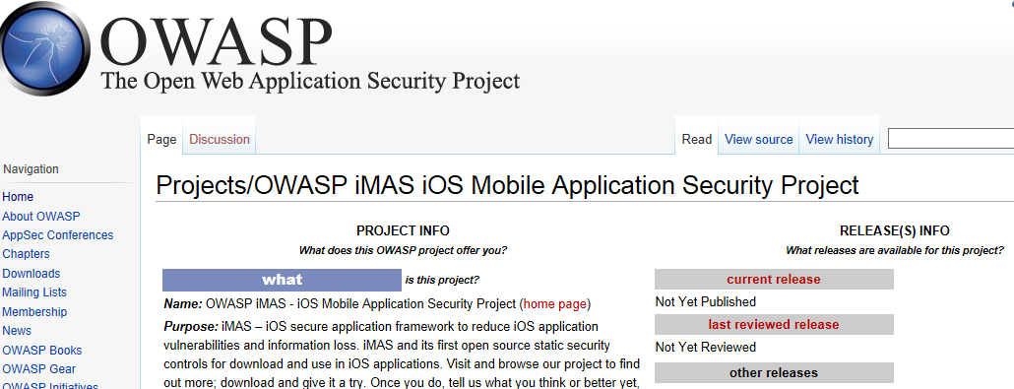

Research Idea: iMAS Secure Application Framework
iMAS Secure Application Container
iMAS
Native iOS Application
Config Profile
App Signing
App Store
Extended App level Passcode
Jailbreak Detect / Disable
RAM / Debugger lib / techniques
Encrypted App Files and keychain
Internet
iOS Core Services
SSH / Debugger
iOS
iPhone / iPad Hardware
Tolerable Security Risk
Security Controls beyond Apple iOS
Reduces iOS app attack surface
Vetted security control set using CWE
Extends security with or without MDM and COTS solutions
Measurable security (DISA Mobile App SRG)
Open source, grow community
Open Source Community

Slide 8
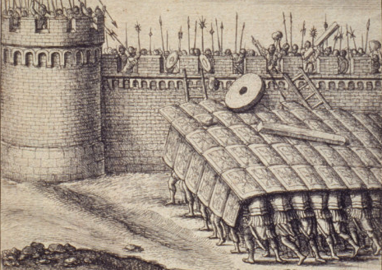
Research Scope
iOS attack surface is multi-faceted
Threat vectors
Lost/stolen device, physical access attacks
Malware inserted via
Apps downloaded from Enterprise App store
Browser JavaScript engine
Attacker purpose
Steal application data, find enterprise credentials
Eavesdropping on video, microphone, and phone calls
C2/Recon into Enterprise networks
iMAS focus - Application use and its data is the target
Enterprise data, tactical operational data, patient health info
Protect against: malware and physical access attacks
Secure Static and Dynamic application controls
© 2013 The MITRE Corporation. All rights reserved. Approved for Public Release: Case #13-2148

Slide 9
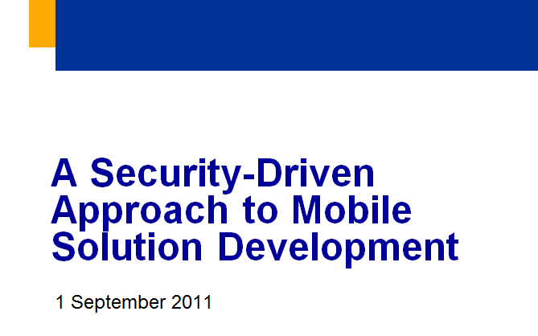
Mobile Threats
DoD CIO Report FY11
24 threats most relevant to the mobile environment
Software-Based Threats
Malware
Exploitation of Vulnerable App
Exploitation of Vulnerable OS
Physical-Based Threats
Loss of Device
Data recovered by unauthorized party
Use of authorized Credentials
Physical Tamper
Supply Chain
Web-Based Threats
Mobile Code
Drive-By-Downloads
Exploitation of Vulnerable Browser
Enterprise-Based Threats
Access to Enterprise Resources
Network-Based Threats
Data/Voice Collection over the air
Bluetooth
WiFi
Cellular
Data/Voice Collection over the network
Manipulation of data-in-transit
Connection to Masqueraded service
Jamming
GPS
Mobile Carrier
WiFi
Flooding
User-Based Threats
Social Engineering
Phishing / Spear Phishing
Theft/Misuse of Services
Malicious Insider
Tracking
Geolocation
Tower/Signal Traingulation
Geotagging
Mining of Call Records / Billing
Usage Patterns
10 iMAS Applicable
© 2013 The MITRE Corporation. All rights reserved. Approved for Public Release: Case #13-2148

Slide 10

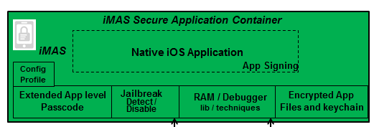
iOS Security Architecture
Developer Access
Apple Only
Apple Only
© 2013 The MITRE Corporation. All rights reserved. Approved for Public Release: Case #13-2148

Slide 11




iMAS App Security “trade-space” Comparison Goal: Sep 2013
Change over time
(arrow size = rate of change)
Security Controls
Open Source
Art of the Possible (2014+)
iOS w/iMAS
with or without COTS
iMAS (Sep 2013)
iMAS
iOS w/COTS
MDM
App
Containers
iOS
iMAS controls raise security levels, bringing it closer to the Art of the Possible
iOS
iMAS
State of the Art (Oct 2012)
Consumer
Enterprise
Enterprise+
Unclassified (Internet)
Sensitive (NIPRNET/MITRE)
Classified (SIPRNET/JWICS)
iMAS (Sep 2013)
Mobile App Classification Level
State of the Art (Oct 2012)
© 2013 The MITRE Corporation. All rights reserved. Approved for Public Release: Case #13-2148

Slide 12
Security Controls Breakout
Passcode Check
Programmatic library and method to enforce complex device passcode use
When in place, extends jailbreak bruteforce passcode guessing duration to years from minutes
App-Password
Secure, simple, user resettable password to protect access to an application and its data
App level authentication enhances defense in depth
Rotating keypad
Encrypted-core-data
iOS CoreData encrypted SQLite store using SQLCipher
iMAS has made it easy for developers to incorporate a secure SQL DB
Future: handle more relationship cases (1 to many, many to many)

Slide 13
Security Controls Breakout (cont.)
Security-Check
Application level, attached debug detect and jailbreak testing
iMAS added extensive anti-forensic techniques to this library including; C macro functions, nameless function blocks, callback based, easy thread spawn for continuous checking.
Secure Foundation
OpenSSL based secure components enabling application authentication, secure file storage, and app level file-based keychain
iMAS alternative to Apple provided crypto support
iOS OpenSSL FIPS
FIPS compliant openSSL drop-in ready for iOS

Slide 14
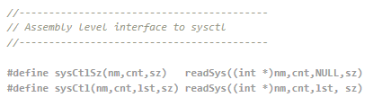
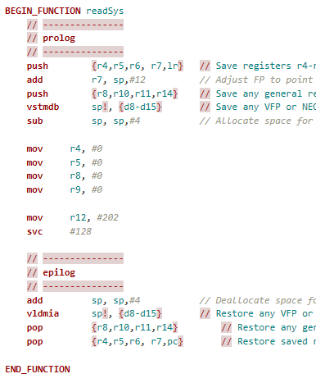
Security Check Deep Dive
Jailbreak and debug attach detection
Two Interesting iMAS techniques
Sysctl
Using sysctl call to detect if debugger is attached
Forensically attacker can “catch” this and simply override to return false
Instead, iMAS is making direct assembly call to read process flag directly
LW Threads
Making calls to JB and debugger detect repeatedly
Both techniques are enormously more difficult to work around

Slide 15
FY13 Additional Controls
Encrypted Code Modules (ECM) investigation
Encrypt critical portions of code as a run-time loadable library
Invulnerable to static attack vector
Mitigates run-time attack when coupled with security check control
Run-time memory security research
Application program address validation checks at run-time
Scrub memory on app exit
App Integrity check research
Leverage ECM to wrap “app checksum” algorithm ensuring trust
Encrypted RAM disk research
Research bundling a FOSS TrueCrypt RAM disk with an app; allows for rapid data destruction on app exit

Slide 16
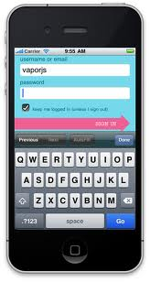



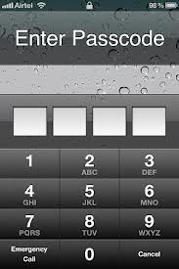
ECM – Encrypted Code Modules Concept
Build Time
ECM built into iOS App
ECM
DynamicLib
Builder
At Install User enters ECM App Key
iOS App
iOS App
ECM
DynamicLib
Encrypted w/User app password
ECM
DynamicLib
Plaintext
.dylib
ciphertext
DynamicLib
ECM Decoder
ECM Decoder
Protected Functionality
Secured with ECM App Key
iMAS Security
iMAS Security
On Device
In Use:
At Rest:
iOS App
iOS App
Critical Functionality Encrypted
ECM
DynamicLib
ECM
DynamicLib
ECM Decoder
ECM Decoder
iMAS Security
User Enters app password
iMAS Security
Critical Functionality Unlocked
Invulnerable to Decompiling

Slide 17
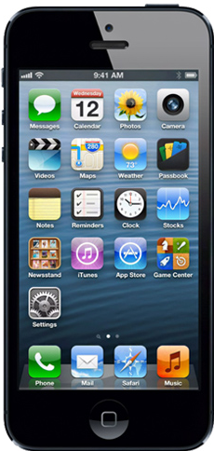
iMAS – Security Control Mapping
Device Access:
Run-time:
AppStore / Malware:
4 Digit Passcode
RAM and Debugger
App Tampering
Passcode
Check
Encrypted Code Modules (ECM)
Jailbreak / Root Access
App Access:
AppIntegrity Check
Security-Check
Jailbreak / debugger attach
None
AppSignature
Check
AppPassword
Memory Security
Data in Transit:
Data At Rest:
Encrypted RAM Disk
Out of Scope
Keychain
CoreData
Encrypted Core Data
Lightning Connector
MDM Remote Control
iMAS
Vulnerable Areas
Secure Foundation OpenSSL / FIPS
Future
Future Research

Slide 18

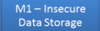
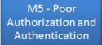
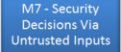
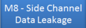
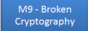
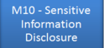
iMAS Availability
Security Areas:
Available Today on github
June 2013: hReader audit refresh
July - Sep 2013: Active Research
AppPassword
App authentication
Encrypted SQLite
Data at rest protection
App at rest security
Device Passcode check
Jailbreak detection
Debugger attach detect
FIPS compliance openSSL
Passcode
Check
Security-Check
Jailbreak / debugger attach
Encrypted Core Data
Secure Foundation OpenSSL
OpenSSL FIPS
Security-Check
Jailbreak / debugger attach
Encrypted Core Data
AppPassword
Applicable OWASP Mobile Risks (6 out of 10)
Memory Security
Time Permitting Research:
AppSignature
Check
Encrypted RAM Disk
iMAS
AppIntegrity Check
Encrypted Code Modules (ECM)
© 2013 The MITRE Corporation. All rights reserved. Approved for Public Release: Case #13-2148

Slide 19
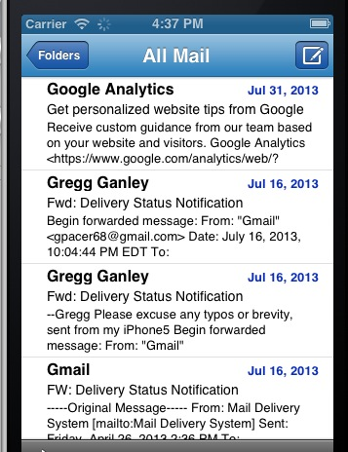
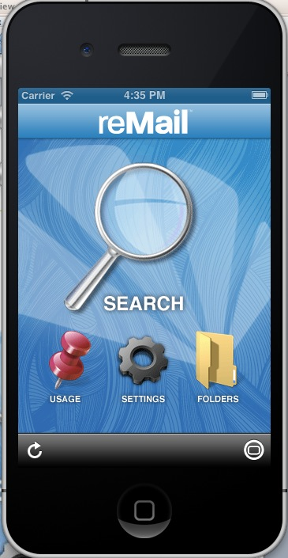
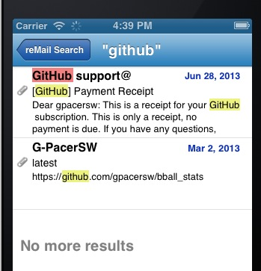
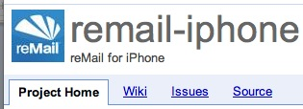
reMail http://code.google.com/p/remail-iphone/
FOSS project acquired by Google in 2010
Email client for iOS
Project TODO ideas lists “security needed”
iMAS test app
Wrap app with iMAS security controls
Github project started

Slide 20
iMAS Applied

Slide 21

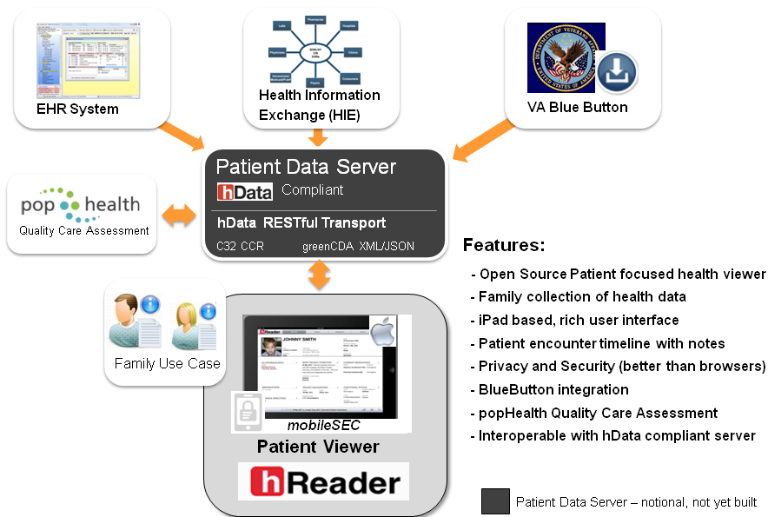
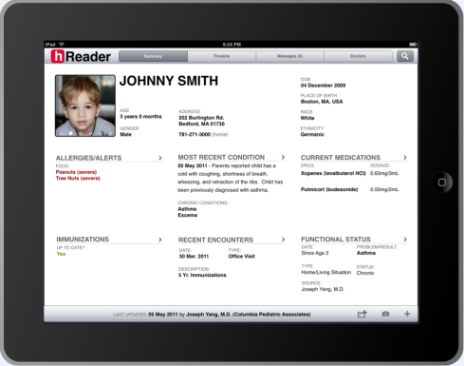
FY12
MITRE Internal Research - MIP
mobile Patient Health Reader
© 2013 The MITRE Corporation. All rights reserved. Approved for Public Release: Case #13-2148

Slide 22
Audit Summary August 2012
hReader team targeting Open Source space for hReader application
hReader would be used mostly offline
Application security needs to be bolstered
Production hReader app would be contain sensitive patient health information
hReader requested a red-team to security audit the application
Test app contains “synthetic” patient data; NOT real patient data
A DISA App security STIG checklist was used to measure the security compliance
Iterative process over several months
First pass, many areas were found to be exposed
Third pass, considerably more secure
© 2013 The MITRE Corporation. All rights reserved. Approved for Public Release: Case #13-2148

Slide 23
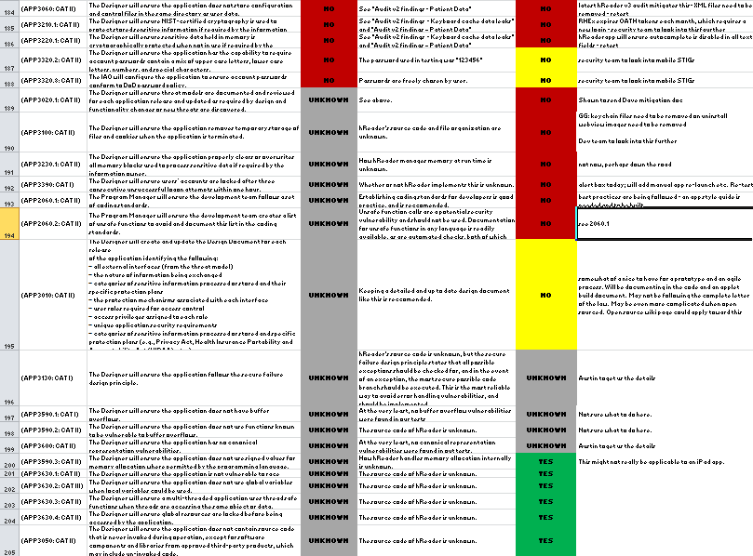
STIG Compliance Security Technical Implementation Guide
DISA / DoD Application STIG
255 total criteria
78 Applicable to hReader as a mobile prototype
Initial assessment
27 pass (16%), 10 fail, 129 unsure (166 Total), 89 NA
After several audits
72 pass (90%), 8 fail (80 total), 175 NA
hReader application security compliance increased to 90% criteria met – about a 5X increase from original design
STIG – A specification that defines the configuration standards for DOD IA and IA-enabled devices/systems
STIG used: Application Security and Development STIG Version 3, Release 3
© 2013 The MITRE Corporation. All rights reserved. Approved for Public Release: Case #13-2148

Slide 24
Outreach

Slide 25
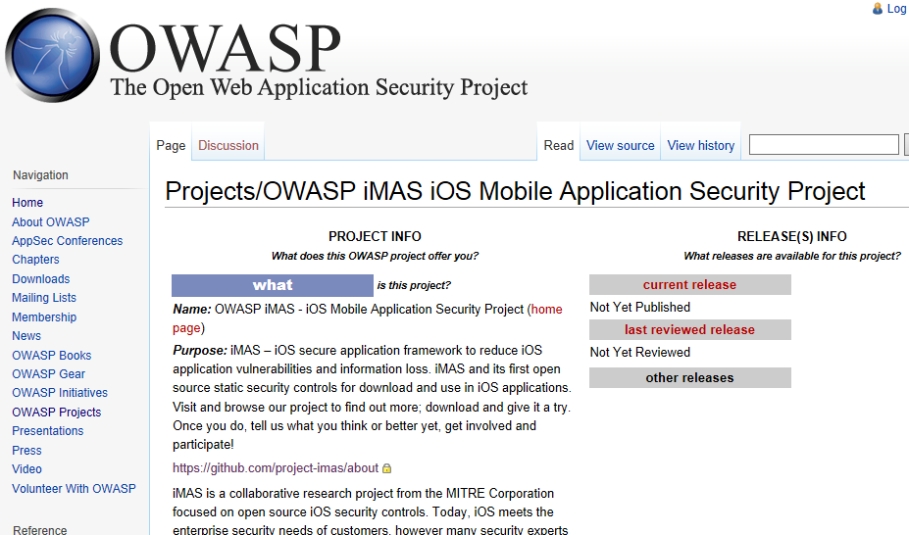
iMAS Now an OWASP Project

Slide 26
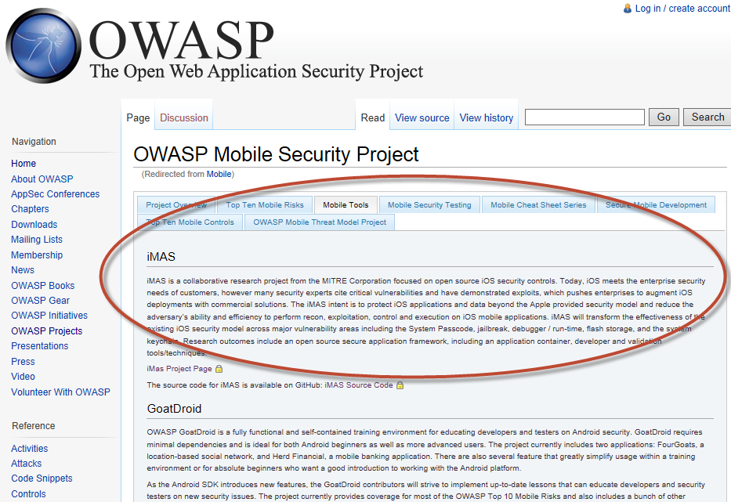
iMAS listed as OWASP Mobile Security Project – Mobile Tool

Slide 27
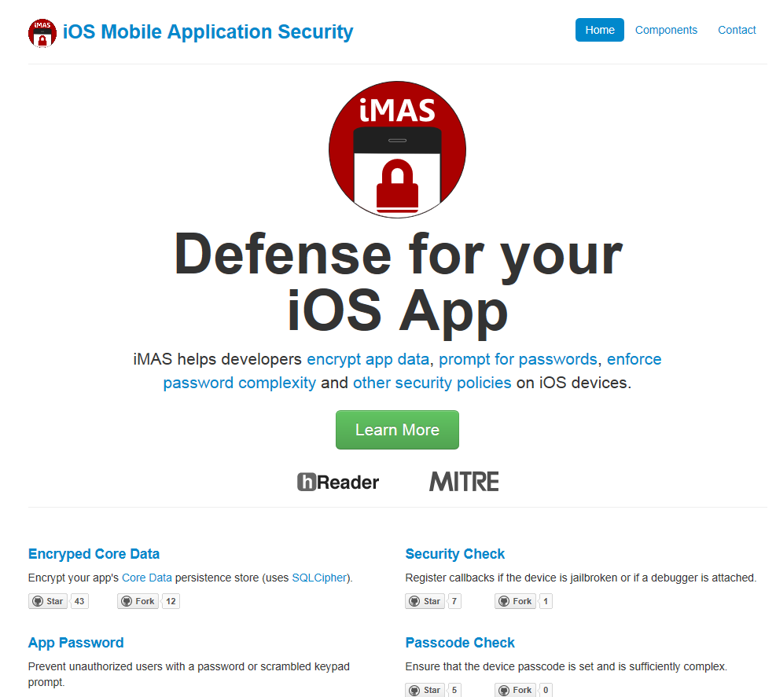
Web Site project-imas.github.com

Slide 28
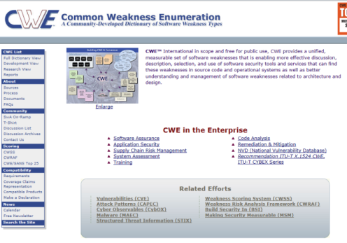
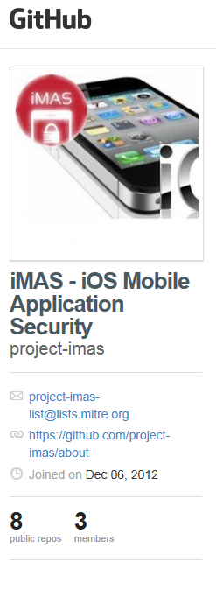
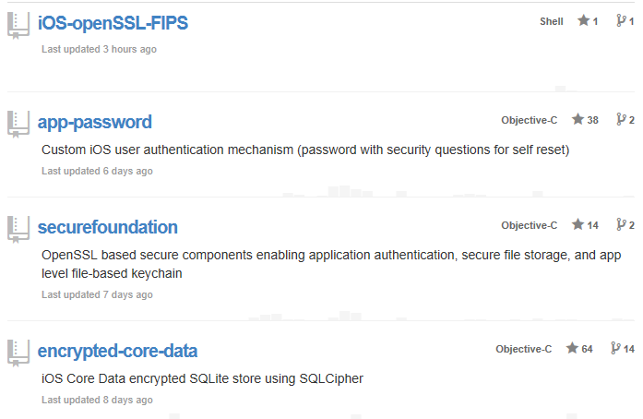
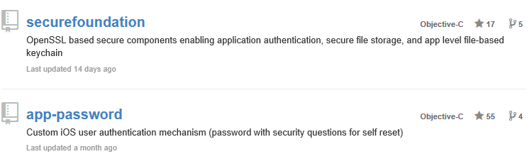
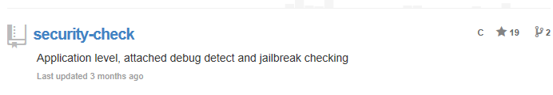
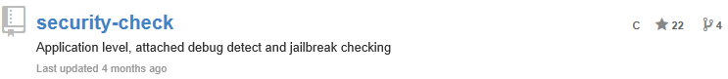
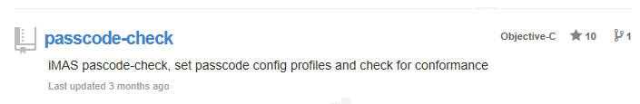
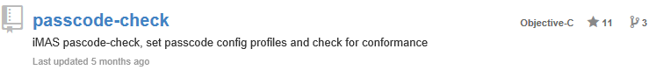
Github.com site Six iMAS security controls available

Slide 29
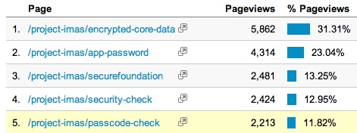
Github Use and Value Claim: value = visits and use
Open source statistics
Leveraging githalytics.com
Adds a Google analytics link to each iMAS security control README file
Since March 4 (about five months)
Over 11,800 unique visitors, 18,700 page views (91% new, 9% returning)
Visits from 92 countries (mostly US, Germany, India, UK, Italy)
Site Numbers
Community starting to
follow:
Star count 214 (up from 197 on 7/5)
43 forks (up from 36 on 7/5)
Value measure
Moderate, steadily increasing

Slide 30

iMAS Video
Produced as part of MITRE’s Mobile Computing Security Initiative (MOCSI) integration effort
Short, 3.5 minutes
http://youtu.be/92A3kg_kUSc

Slide 31


iMAS in the news …
…
…
© 2013 The MITRE Corporation. All rights reserved. Approved for Public Release: Case #13-2148

Slide 32
iMAS Future

Slide 33
FY14 Technical Approach and Research
Deeper security controls
Continue researching security controls (those not finished in FY13)
Advanced resilience and disruption techniques
iMAS Encrypted Code Modules research
Implement portions of security controls using iMAS ECM technique
Dynamic App Bundling research
Research app repackaging techniques; wrap app after build time
MDM remote control
Explore securing MDM interface and remote C2 capabilities for iMAS controls (remote wipe etc.)
Off device trust
iOS Lightning Connector and trusted smart charger research
Reference app bolstering
Implement iOS reference app (reMail) using iMAS ECM / SMIME
Third Party Audit reMail with viaForensics and Veracode

Slide 34





iMAS Secure Application Framework FY14
Security Areas:
iMAS Secure Application Container
App authentication
Data at rest protection
App at rest security
Device Passcode check
Jailbreak detection
Debugger attach detect
Encrypted SQLite
FIPS compliance
Lighting Connector Off Device Trust
Dynamic application security bundle
Secure Keychain
Memory scrub after use
Dynamic memory usage check
Remote Wipe
iMAS
Native iOS Application
Secure MDM Control
AppPassword
Passcode
Check
Security-Check
Jailbreak / debugger attach
Encrypted Core Data
ECM
Encrypted Code Modules
AppIntegrity Check
AppSignature
Check
Encrypted RAM Disk
Memory Check
Secure Foundation OpenSSL FIPS
Dynamic App Bundling
Off Device Trust Check
iOS Core Services
App Store
SSH / Debugger
iOS
Malware
Tolerable
Security Risk
iPhone / iPad Hardware
Enterprise
App Store
Security Controls beyond Apple iOS
Reduces iOS app attack surface
Vetted, prioritized security control set
Open source, grow community
Open Source
github.com/project-imas

Slide 35


End Game iMAS Goals
Targeting “secure complete” when applicable OWASP mobile top 10 and 10/24 mobile threats are mitigated
Open Source is self sustaining
Transition –
Govt. and / or Commercial entity

Slide 36
Questions?
iMAS - iOS Mobile Application Security
Github:
https://project-imas.github.com
POC:
MITRE, Bedford MA
Gregg Ganley
781-271-2739
gganley@mitre.org
Gavin Black
781-271-4771
gblack@mitre.org
Please !
Visit and browse our project to find out more; download and give it a try. Once you do, tell us what you think or better yet, get involved and participate!
© 2013 The MITRE Corporation. All rights reserved. Approved for Public Release: Case #13-2148

Slide 37
Backup

Slide 38






iMAS iOS Mobile Application Security
Gregg Ganley
Gavin Black
Problem
iOS is considered secure, but out of the box security is not enough
Simple device passcodes enable easy compromise of applications and data
Solution
Additional security controls beyond Apple
Reduce iOS app attack surface
Extends security with or without MDM and COTS solutions
Measurable security (DISA Mobile App SRG)
Controls open source available
project-imas.github.com
Raise iOS app security levels - closer to the Art of the Possible

